Slide 1
Helpful Techniques
Instructor: Dr. Yan Yan

Slide 2
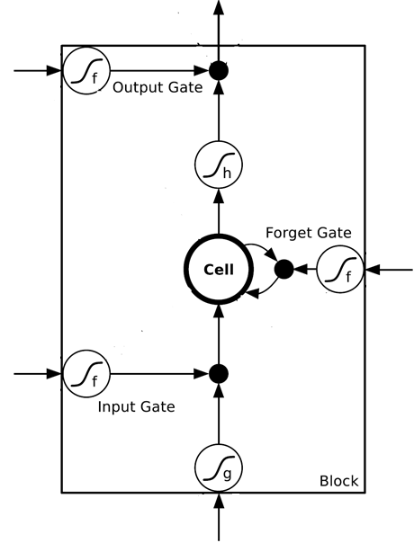
Helpful Techniques
Long Short-term Memory (LSTM)
Can deal with gradient vanishing (not gradient explode)
Memory and input are added
The influence never disappears unless forget gate is closed
No Gradient vanishing
add
(If forget gate is opened.)
Gated Recurrent Unit (GRU):
simpler than LSTM
[Cho, EMNLP’14]

Slide 3
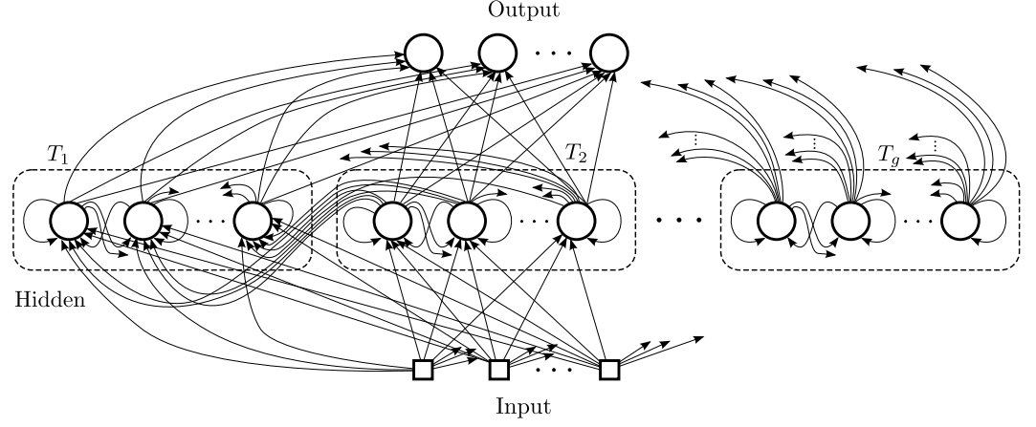
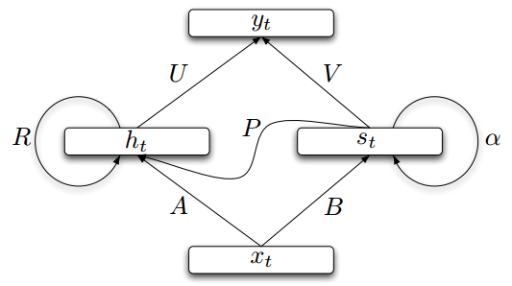
Helpful Techniques
Structurally Constrained Recurrent Network (SCRN)
Clockwise RNN
[Jan Koutnik, JMLR’14]
[Tomas Mikolov, ICLR’15]
Vanilla RNN Initialized with Identity matrix + ReLU activation function [V. LQuoce, arXiv’15]
Outperform or be comparable with LSTM in 4 different tasks

Slide 4

More Applications ……
Probability of “arrive” in each slot
Probability of “Taipei” in each slot
Probability of “on” in each slot
y¹
y²
y³
Input and output are both sequences with the same length
store
store
a¹
a²
a³
a¹
a²
RNN can do more than that!
x¹
x²
x³
arrive Taipei on November 2nd

Slide 5
Many to one
Input is a vector sequence, but output is only one vector
Sentiment Analysis
Awesome
Good
Feel great after watching this movie …….
This movie is too bad
…….
This movie is awesome …….
Normal
Bad
Positive
Negative
Positive
Terrible
……
This
movie
is
……
really
too
bad

Slide 6

Demo: Image Caption Generation
Input an image, but output a sequence of words
[Kelvin Xu, arXiv’15][Li Yao, ICCV’15]
A vector for whole image
a
woman
is
===
CNN
……
Input image
Caption Generation

Slide 7
To Learn More ……
The Unreasonable Effectiveness of Recurrent Neural Networks
http://karpathy.github.io/2015/05/21/rnn-effectiveness/
Understanding LSTM Networks
http://colah.github.io/posts/2015-08-Understanding-LSTMs/

